Slide 1
A Security Model for Preserving the Privacy of Medical Big Data in a Healthcare MultiCloud Using a Fog Computing Facility with Pairing-Based Cryptography
Presented By
Priyanka Rathod
Akshata Patekar
Pratiksha Bhalerao
Rishabh Shukla
Guide: Prof. Swapnil Shinde.

Slide 2
Problem Statement
Healthcare system faces different security issues such as data theft and leakage of information same data and key store on same cloud it will be easily hack by attacker of healthcare data or some malicious activity has to be done .

Slide 3
Literature Survey
Sr.no | Reference Name(Paper title) | Seed Idea/Work Description | Problems Found | Any other criteria
1 | A Security Model for Preserving the Privacy of Medical Big Data in a Healthcare Cloud Using a Fog Computing Facility with Pairing-Based Cryptography | Fog computing is used with Pairing based cryptography | Possibility of leakage of Healthcare data | Multicloud concept is used to preserve the healthcare data
2 | Disease Prediction by Machine Learning Over Big Data From Healthcare Communities | latent factor model is used to reconstruct the missing data | difficulty of incomplete data | new convolutional neural network (CNN)-based multimodal disease risk prediction algorithm using structured and unstructured data from hospital.

Slide 4
Literature Survey
Sr.no | Reference Name(Paper title) | Seed Idea/Work Description | Problems Found | Any other criteria
3 | Securing photos in the cloud using decoy photo gallery | Securing cloud data, particularly photos using Fog computing | Security Issues like data theft attack | fog computing is considered as a way to create decoy information and locate it beside the real information in the cloud to hide the true data of the user.
4 | Privacy Preserving Healthcare System using secured cloud environment | An integrated algorithm technique is used for the jointly involved parties which is included privacy and security algorithm; it can protect data integrity also. | wireless sensor network security relevant issues | better secured database access and maintain privacy for all patient data than the traditional database

Slide 5
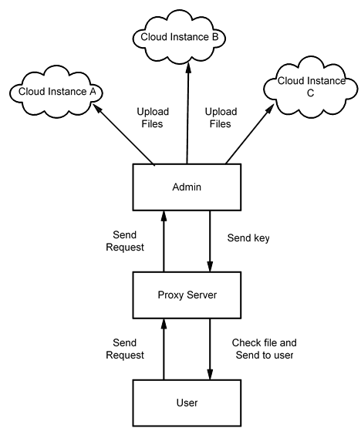
System Architecture

Slide 6
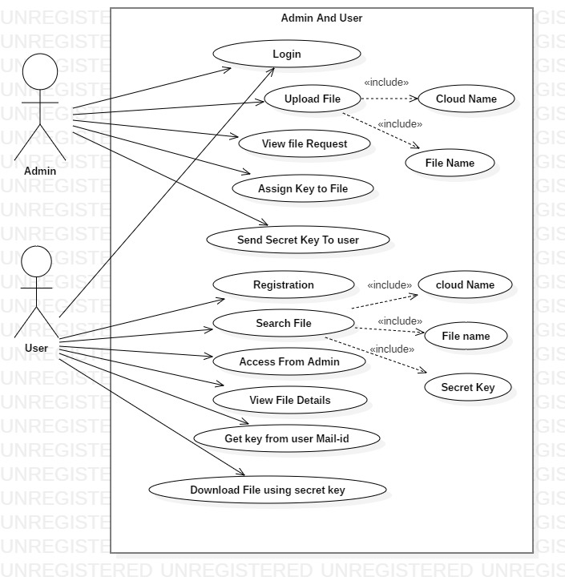
Admin Use Case Diagram

Slide 7
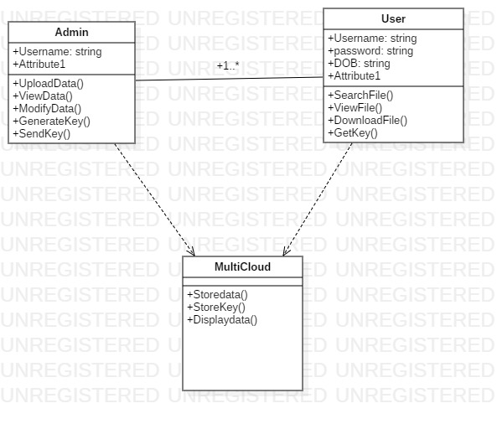
Class Diagram

Slide 8
Scope Of Project
This is used for medical data security using Multi cloud and fog computing.

Slide 9
Software Requirement Specification
Functional Requirements:
System Features:
Here we propose a Security model for healthcare Big Data namely A Security Model for Preserving the Privacy of Medical Big Data in a Healthcare MultiCloud Using a Fog Computing Facility with Pairing-Based Cryptography.
External Interface Requirements:
1) User Interface
Home page
MultiCloud Computing
Store Healthcare Data
Provide Security using Encryption, Fog computing and Pairing-Based Cryptography.
2) Hardware Interfaces
The entire software requires a completely equipped computer system including monitor, keyboard, and other input output devices.
3) Software Interfaces
The system can use Microsoft as the operating system platform. System also makes use of certain GUI tools. To run this application we need JDK 1.8 and above as java platform and Apache tomcat as server. To store data we need MySQL database.

Slide 10
Software Requirement Specification
Non-Functional Requirements:
Accuracy :
Proposed Framework will give data Security.
Failure handling :
System components may fail independently of others. Therefore, system components must be built so they can handle failure of other components they depend on.
Openness :
It supports Online Data Streaming.
Security requirements
Private links can send on users mail id.
Software quality attributes
Usability :
The software will be embedded in a website. It should be scalable designed to be easily adopted by a system. Any user can handle system user friendly.
Reliability :
The system should have accurate results and fast responses to user’s changing habits.

Slide 11
System Overview
To adding the file in the system the Admin has to login his details first. The details are mail-id, password.
To upload the file the Admin has to give the filename, keywords to identify the file, description about the file.
Then the Admin has to choose the file and upload the file. The uploaded files are downloading by authorized users only.
The unauthorized users do not download the files. The security can be maintained in this module using pairing based cryptography.
Download module the user has to know the file key to download the file. Again user has to login and give the file name to search. The download access is to enable the user and download the file.
The downloaded file can be stored in any important drive in our system. The authorized user only can request the file and also access the file.
If the Admin enable the access rights to download the user has download the file easily. If the Admin does not give the access rights to download the user can’t download the file.
In upload module the Admin has to add the files. If data available on any cloud it will downloaded to user.

Slide 12
Thank You

